Slide 1
Angular

Slide 2
What is Angular
Angular front-end development framework.
For Develop single page application
Developed by Google
MVC Framework
Open Source (free of cost)
Use NPM (Node Package Manager) and Command Line Interface (CLI)
First Release in 14th September 2016
The Current Version is 17.0.0 (2023-11-08)

Slide 3
Angular
Angular JS
Angular is a Re-written version, Structure and upgraded framework.
Angular is based on TypeScript
Angular JS is Oldest Version not in use now.
AngularJS is based on JavaScript

Slide 4
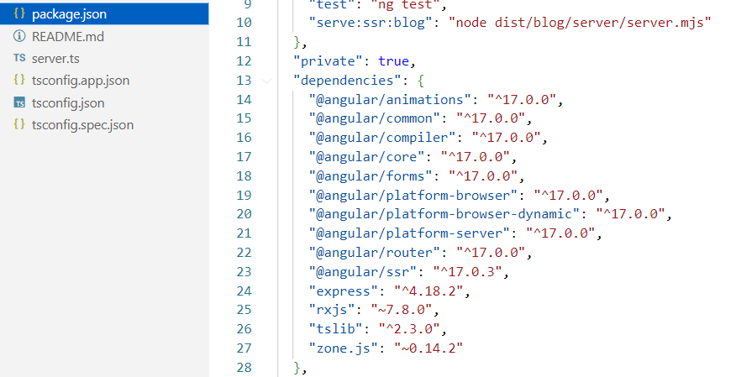
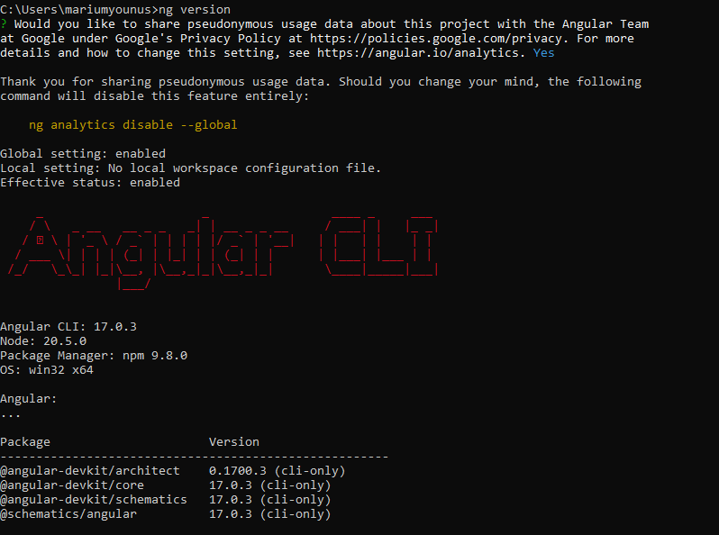
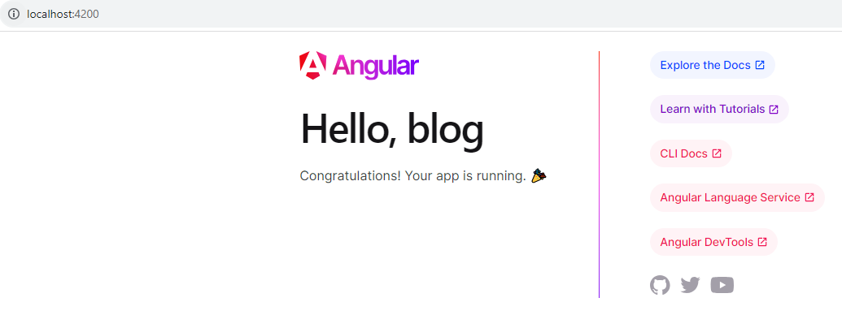
Setup and installation
How to install Node and NPM
How to install angular CLI
Install First angular app
https://nodejs.org/en
https://angular.io/cli
npm install -g @angular/cli
ng version
Create Project
ng new blog
ng new Workshop --no-standalone
(app.module.ts)
cd blog
code . → to open project on editor
ng serve → run server (http://localhost:4200/)
Particular version install
npm uninstall
npm install -g @angular/cli@12.0.0

Slide 5
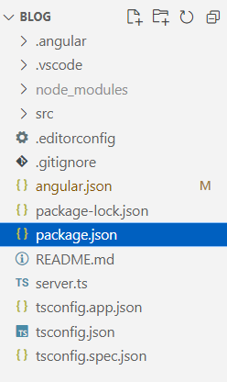
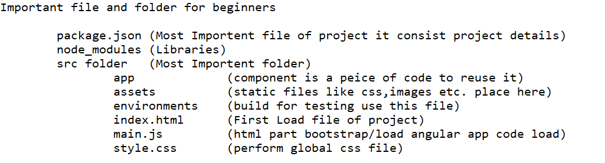
Files and Folder Structure

Slide 6
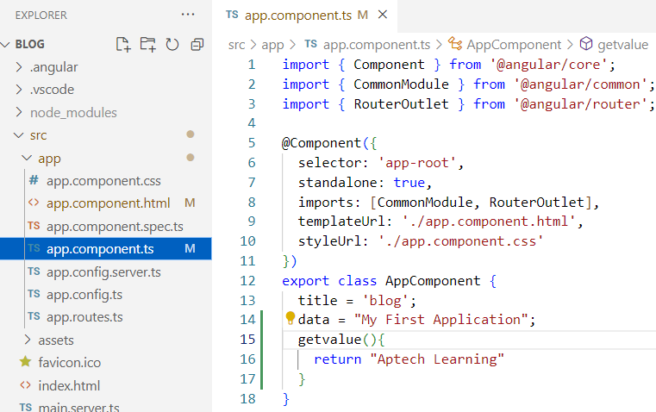
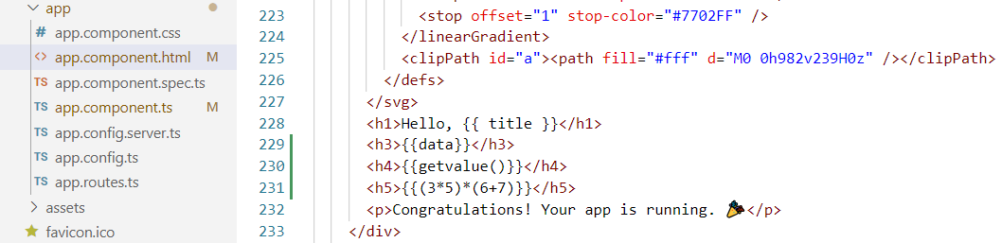
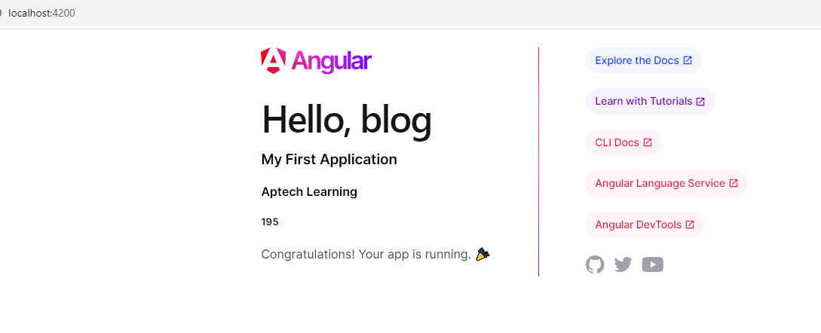
What is Interpolation
In Angular Interpolation is a way to transfer the data from a TypeScript code to an HTML template (view), i.e. it is a method by which we can put an expression in between some text and get the value of that expression. Interpolation basically binds the text with the expression value.
{{interpolation}}
Dynamic Data
index.html

Slide 7
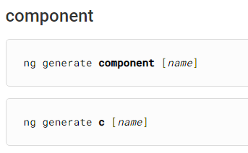
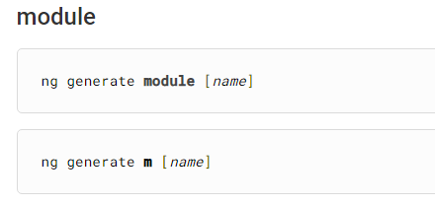
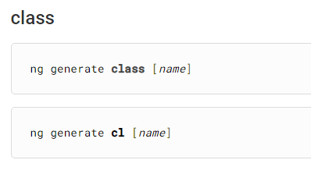
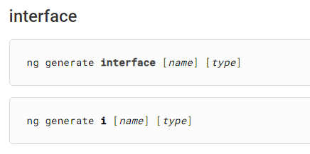
Angular CLI & important Commands

Slide 8
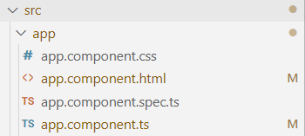
Component
Components are the main building blocks for Angular applications. Each component consists of: An HTML template that declares what renders on the page. A TypeScript class that defines behavior. A CSS selector that defines how the component is used in a template.
Style
HTML Part
Testing
Dynamic data like logical part ,API connection etc.,

Slide 9
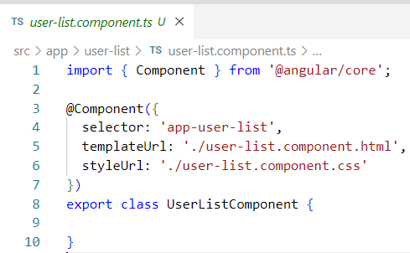
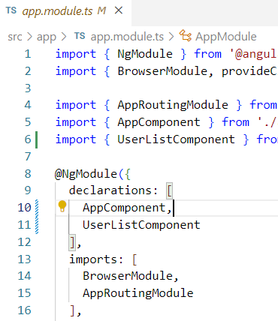
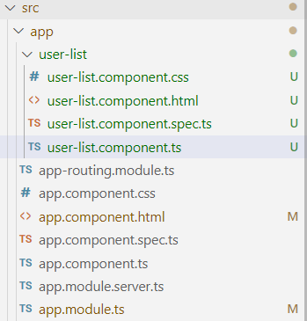
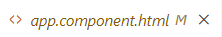
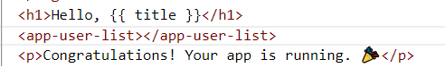
Create New Component
ng generate component user-list
Register here

Slide 10
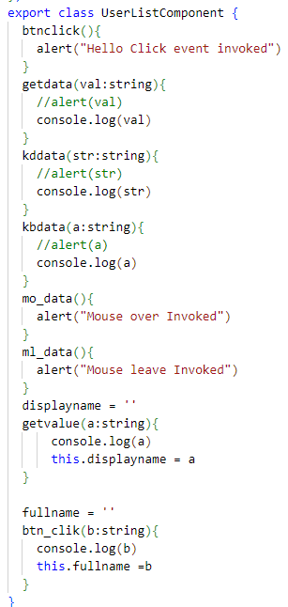
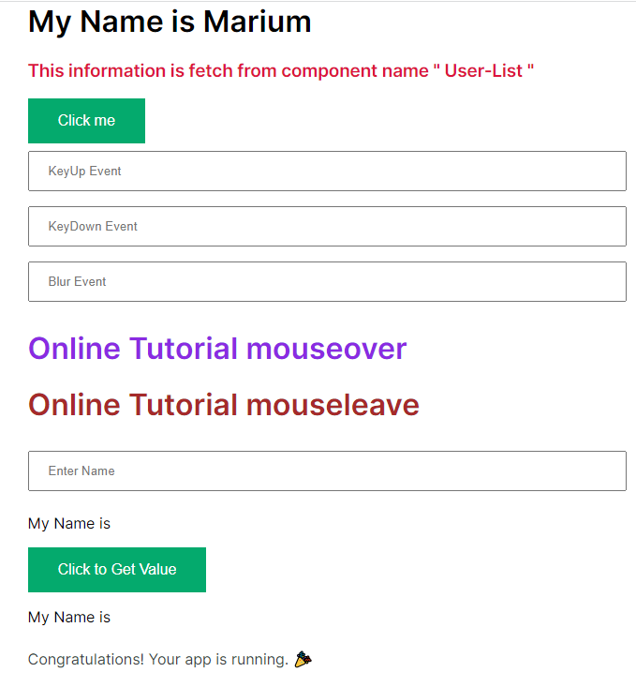
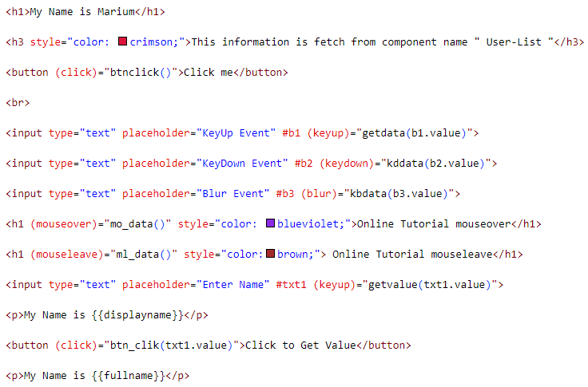
Events in angular

Slide 11
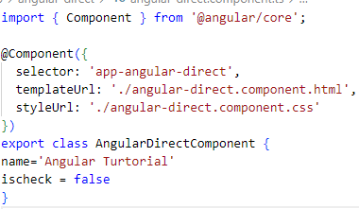
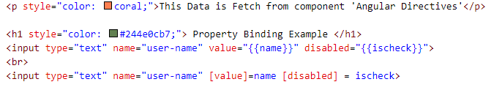
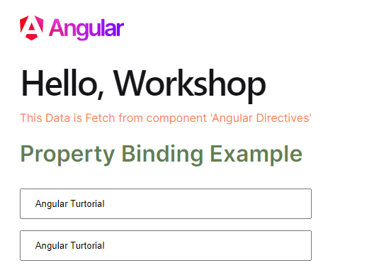
Property Binding
Interpolation
Property Binding is a one-way data-binding technique.
Property Binding

Slide 12
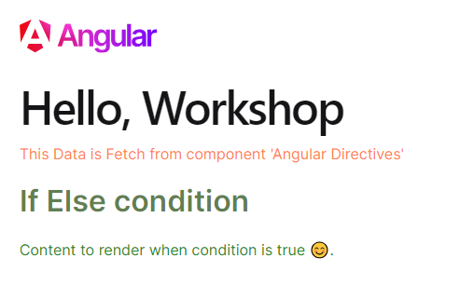
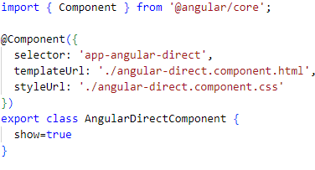
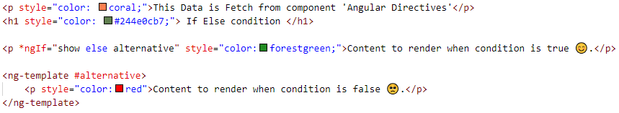
If else condition

Slide 13
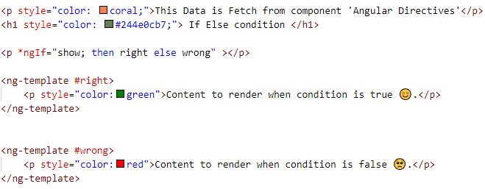
If else condition (Continue)

Slide 14
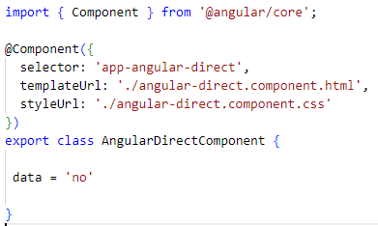
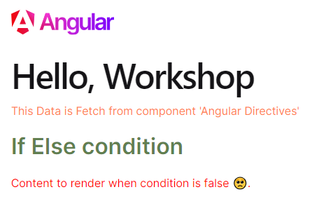
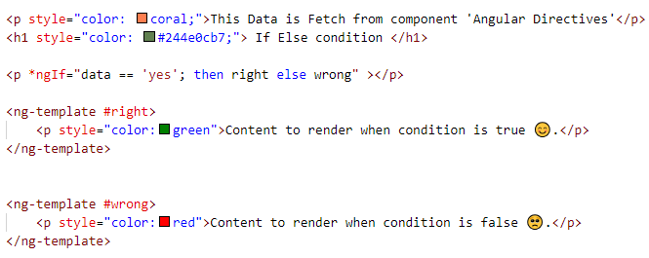
If else condition (Continue)

Slide 15
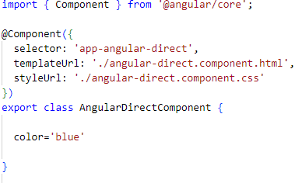
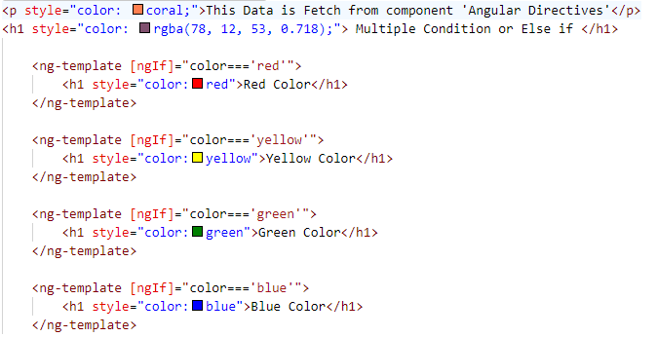
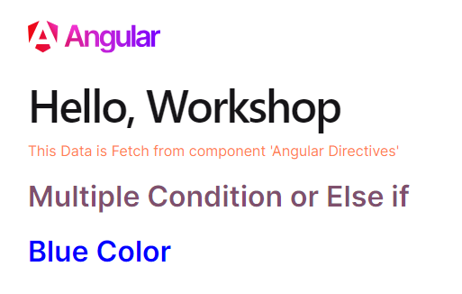
Multiple condition or else if

Slide 16
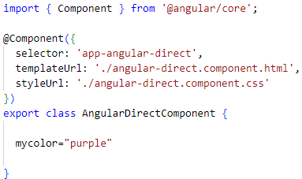
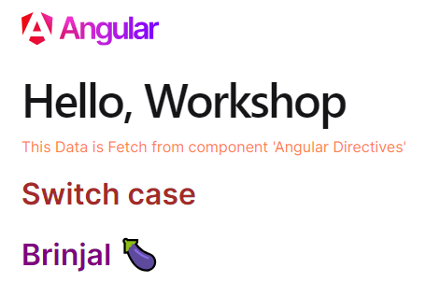
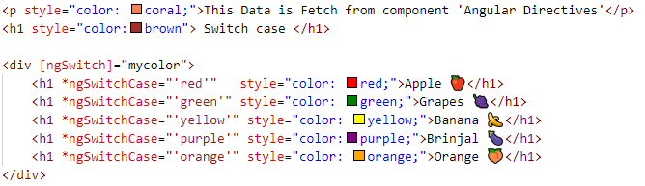
Switch case

Slide 17
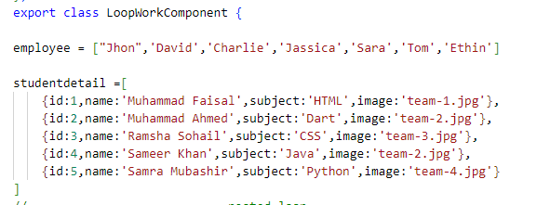
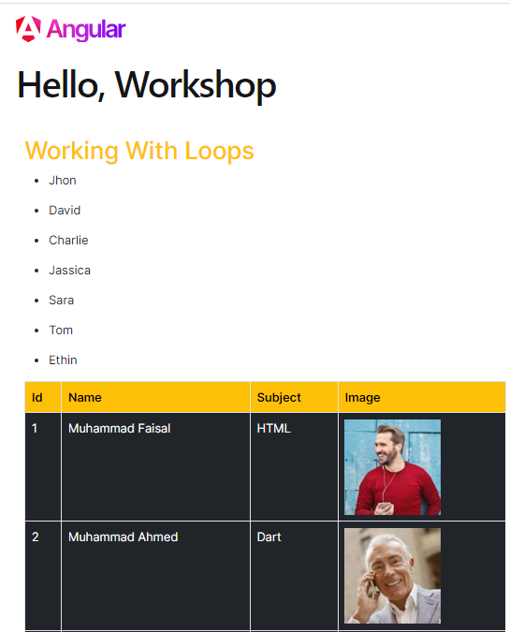
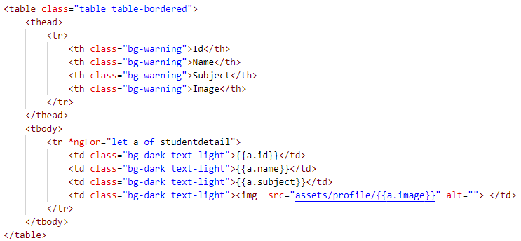
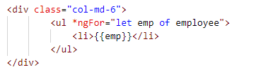
For Loop | *ngFor

Slide 18
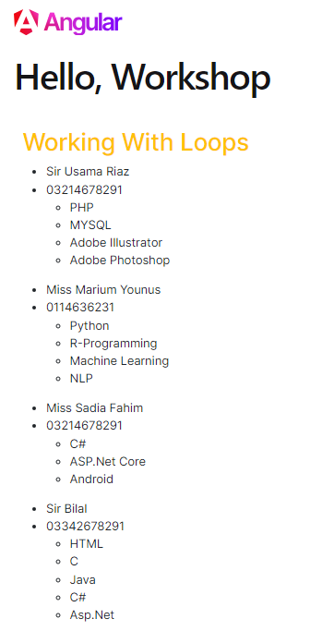
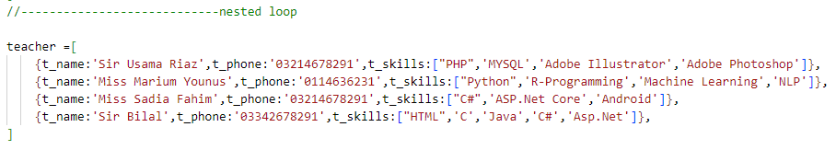
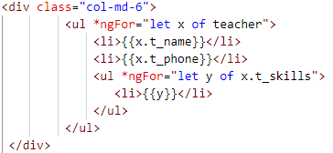
Nested Loop

Slide 19
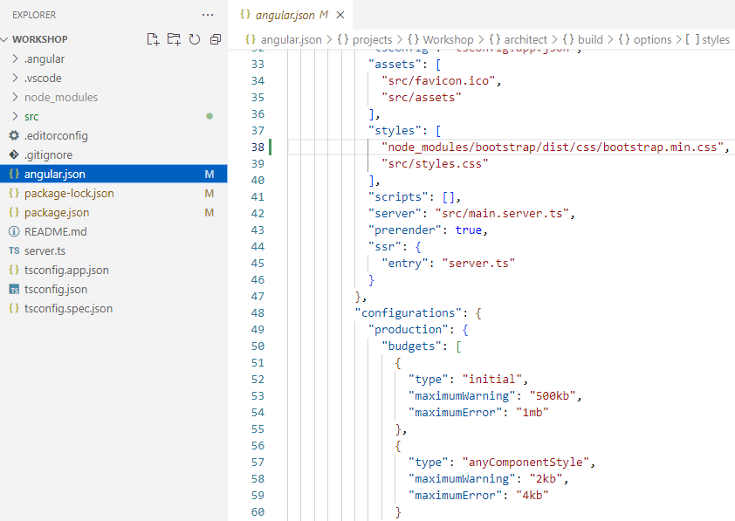
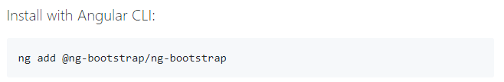
Bootstrap with angular
https://ng-bootstrap.github.io/#/home

Slide 20
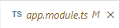
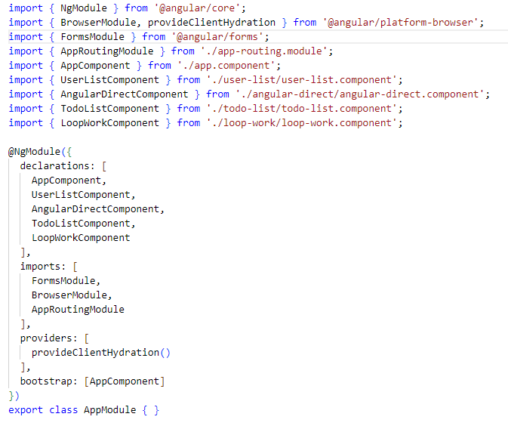
Basic Form (two-way binding)
Import Form Module
Import Form Module
Register Form Module

Slide 21
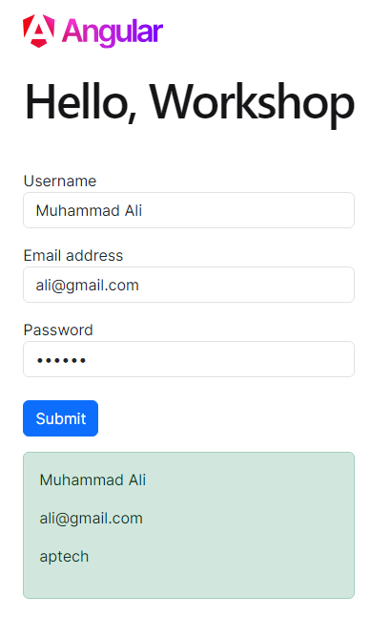
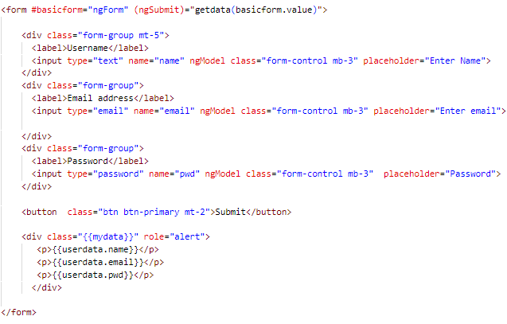

Make Simple Form

Slide 22



Pipes in angular
Angular Pipes allows its users to change the format in which data is being displayed on the screen. For instance, consider the date format. Dates can be represented in multiple ways, and the user can decide which one to use with the help of Angular Pipes

Slide 23




Slide 24



Make custom pipes (Product search Work)

Slide 25


ng g p search

Slide 26




Make To do List

Slide 27



Routing

Slide 28
CRUD Operation in Angular

Slide 29



Slide 30

Install Bootstrap
npm install bootstrap@v5.1.3

Slide 31




Slide 32


Insert Operation Via JSOn Server
https://www.npmjs.com/package/json-server
Install JSON Server
npm install -g json-server
Create a db.json file with some data
Start JSON Server
json-server --watch db.json
Now if you go to http://localhost:3000/posts/1, you'll get

Slide 33


Create Own Inputs Values Add in db.json file
Get user data using ‘userobj’ object

Slide 34


Create Service to Post the data in JSON API DB
Ng g s mydbservice
Add HTTPClient in that service in which you can easily used GET,POST,DELETE api.

Slide 35


Step:01

Slide 36

Code In Service

Slide 37



Show User

Slide 38


Show User data

Slide 39




Delete Work

Slide 40



Update Work

Slide 41




Slide 42


Slide 43

Video CRUD

